Slide 1


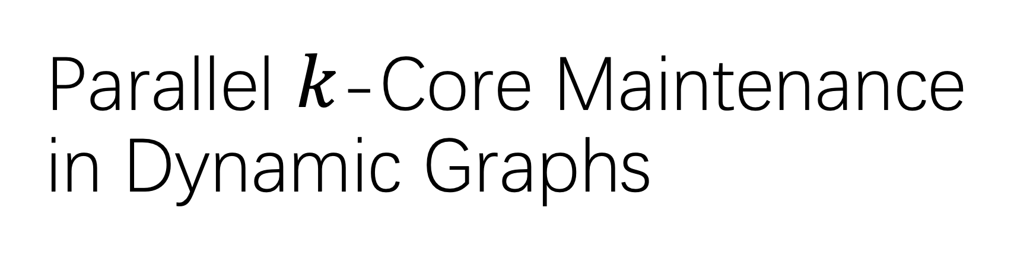
Parallel $k$-Core Maintenance in Dynamic Graphs
Bin Guo (Speaker), Emil Sekerinski
ICPP 2023

Slide 2
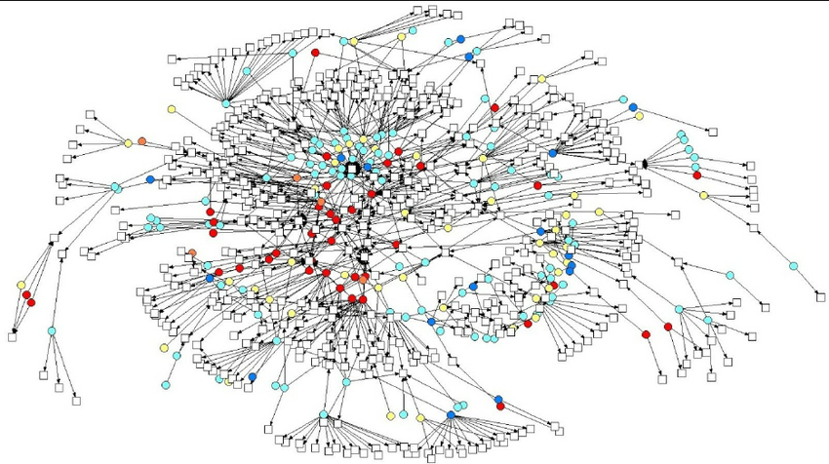


Motivation
Graphs are important data structures used in many applications:
Social Networks: Facebook, Twitter
Knowledge Networks: DBpedia
Biological Networks and Road Networks
Data graphs can be large now:
Facebook has 2.9 billion active users
DBpedia has 6.6 million entities and 13 billion pieces of information
Visualizations of Social Networks show the employee interactions [1]
[1] Kong, Yi-Xiu, et al. "k-core: Theories and applications." Physics Reports 832 (2019): 1-32.
Notes:
Do you know some large graphs?

Slide 3


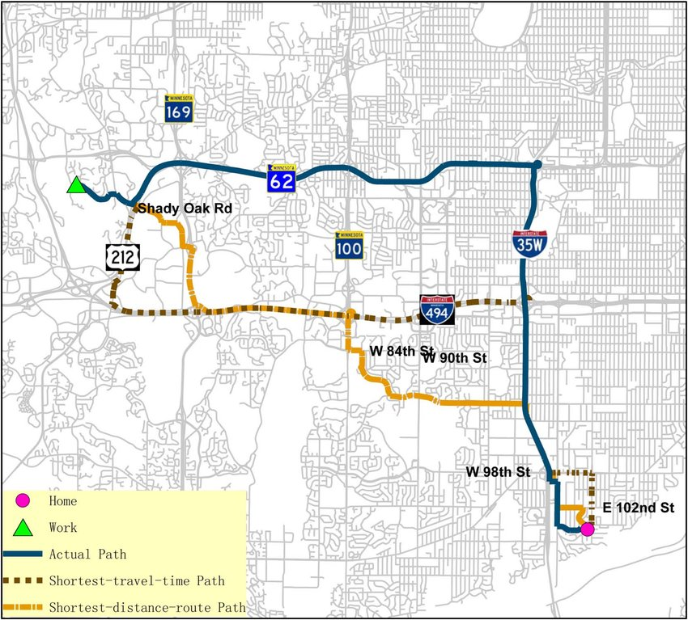
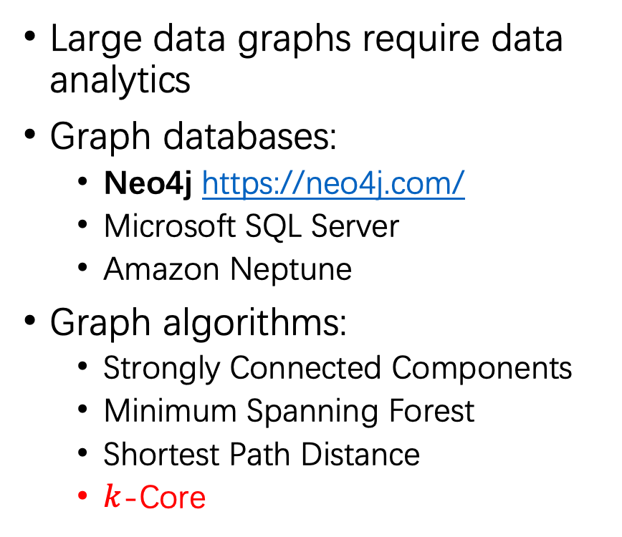
Graph Analytics
Large data graphs require data analytics
Graph databases:
Neo4j https://neo4j.com/
Microsoft SQL Server
Amazon Neptune
Graph algorithms:
Strongly Connected Components
Minimum Spanning Forest
Shortest Path Distance
$k$-Core
Notes:
Check the related graph database

Slide 4
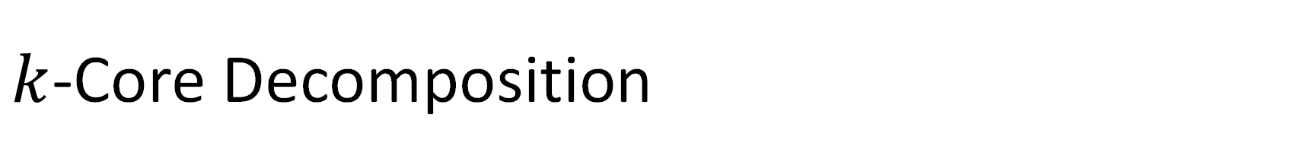
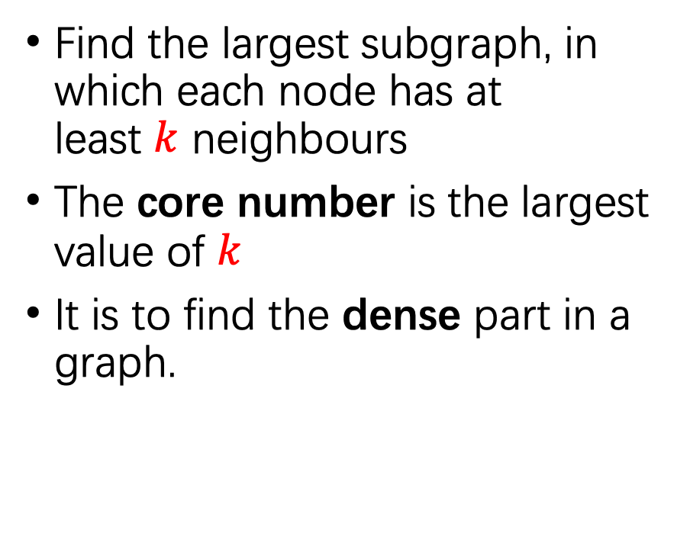
$k$-Core Decomposition
1-core
1-core
1-core
2-core
2-core
Find the largest subgraph, in which each node has at least $k$ neighbours
The core number is the largest value of $k$
It is to find the dense part in a graph.
3-core
core number 1
Most Dense Subgraph
core number 2
core number 3

Slide 5
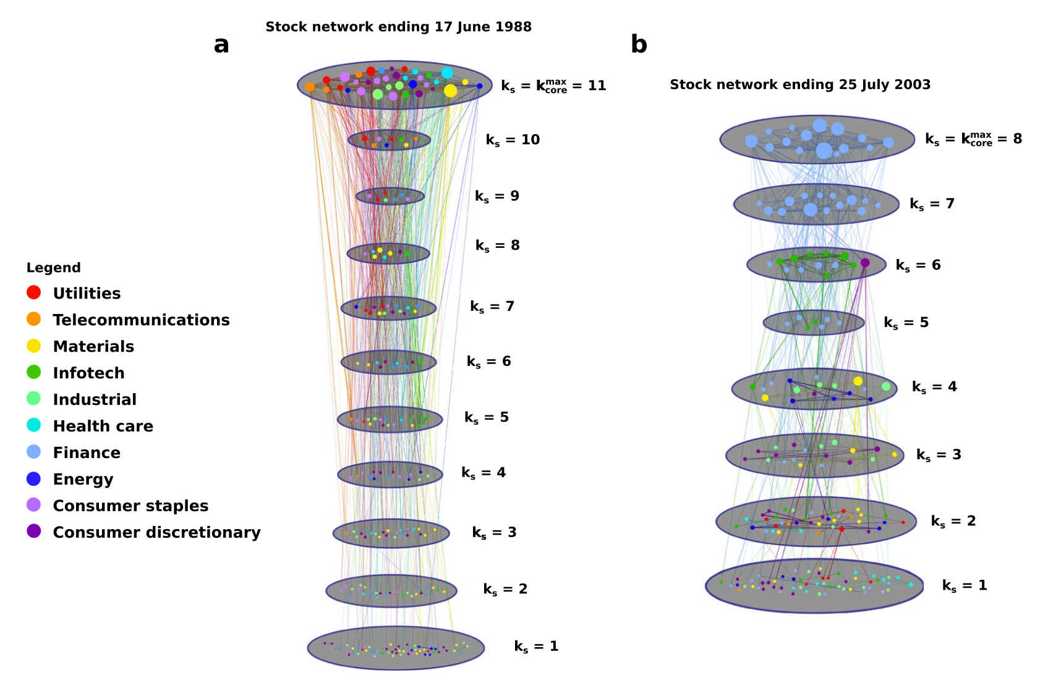
Applications in Economy
max core number
Stock Networks
Vertices | Stocks
Edges | Interaction
The max core is dominated by the Finance in 2003 [2]
Finance has huge effects to economy
[2] Burleson-Lesser, Kate, et al. "K-core robustness in ecological and financial networks.”
Scientific reports 10.1 (2020): 1-14.
Notes:
It means turmoil in the fnancial sector would have negative efects on the stock market and the U.S. economy as a whole.

Slide 6
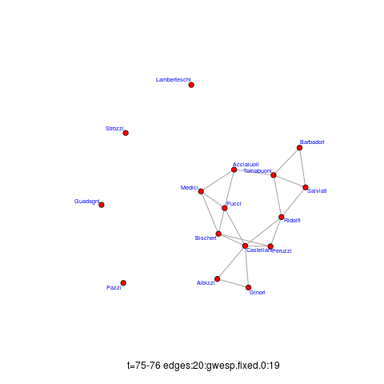
Dynamic Graphs
In practice, all above graphs can be dynamic
Dynamic graphs change with new edges inserted or old edges removed, e.g. temporal graphs
The core numbers have to be updated
Recalculate the core numbers is expensive for large graph
A temporal graph with time-evolving edges [3]. Each edge has a time stamp.
[3] Lotito, Quintino Francesco, and Alberto Montresor. "Efficient Algorithms to Mine Maximal
Span-Trusses From Temporal Graphs." arXiv (2020).

Slide 7
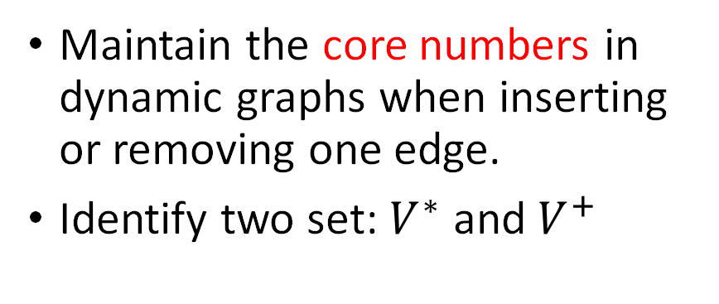

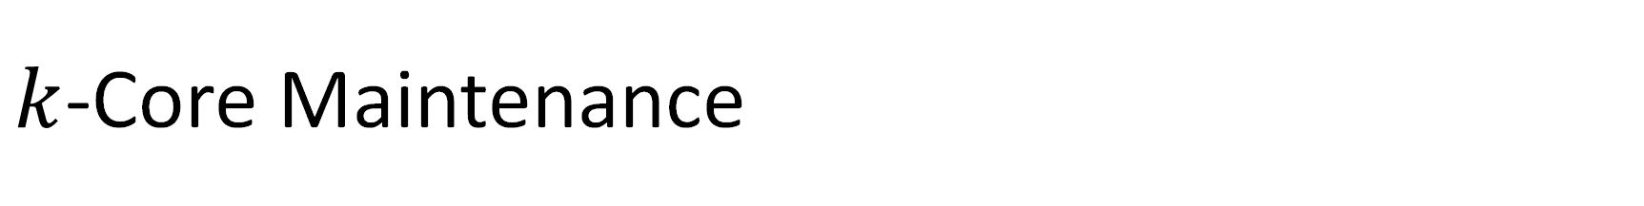
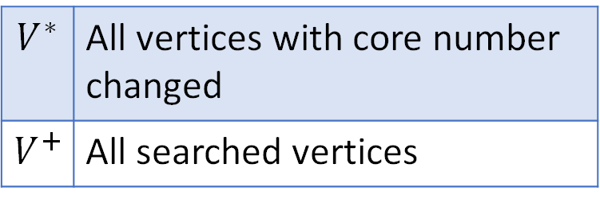
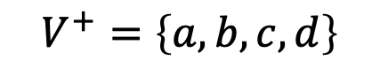
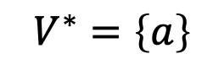
$k$-Core Maintenance
1-core
2-core
Maintain the core numbers in dynamic graphs when inserting or removing one edge.
Identify two set: $V^{∗}$ and $V^{+}$
w
u
v
a
a
e
3-core
$$V^{∗}$$ | All vertices with core number changed
$$V^{+}$$ | All searched vertices
b
d
c
$$V^{∗}=\left\{a\right\}$$
core number 1
$$V^{+}=\left\{a,b,c,d\right\}$$
core number 2
$$V^{∗}⊆V^{+}$$
core number 3

Slide 8
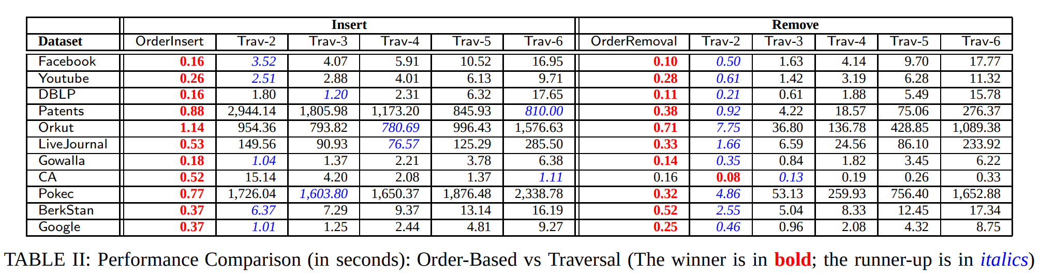
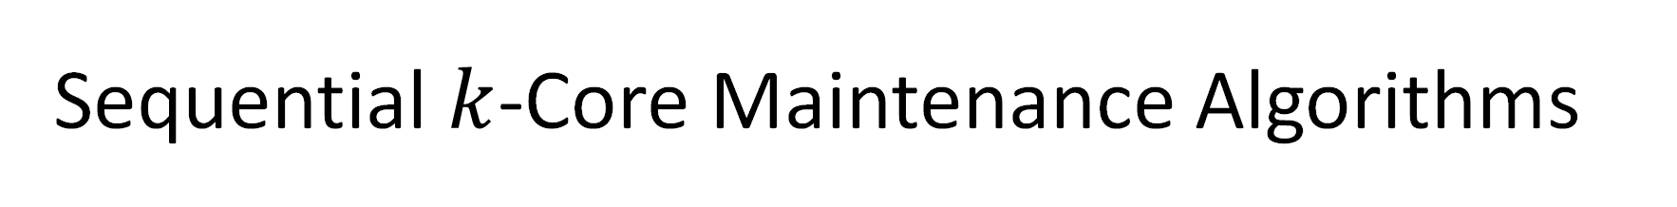
Sequential $k$-Core Maintenance Algorithms
Insert or remove 100,000 edges
(seconds)
(seconds)
Existing Order algorithm is much faster than the Traversal algorithm [4]
Existing Order algorithm maintains an order for all vertices ($k$-order) to reduce the size of $V^{+}$
[4] Yikai Zhang, Jeffrey Xu Yu, Ying Zhang, and Lu Qin. A fast order-based approach for core maintenance.
ICDE, 2017.

Slide 9
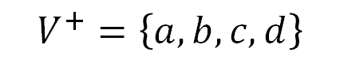

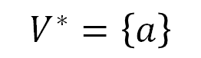
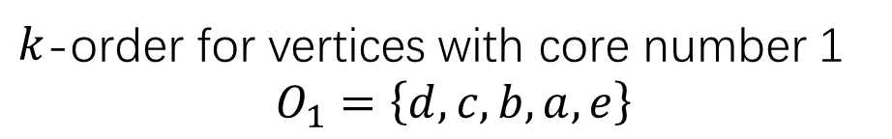

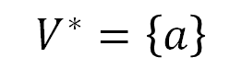
Order vs Traversal
1-core
2-core
w
u
Traversal
$$V^{∗}=\left\{a\right\}$$
$$V^{+}=\left\{a,b,c,d\right\}$$
v
a
a
e
3-core
Order
$$V^{∗}=\left\{a\right\}$$
b
d
c
$$V^{+}=\left\{a\right\}$$
core number 1
$k$-order for vertices with core number 1
$O_{1}=\left\{d, c, b, a, e\right\}$
core number 2
Traverse vertices with $k$-order from $a$, so $b$, $c$, $d$ are omitted
core number 3

Slide 10
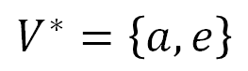

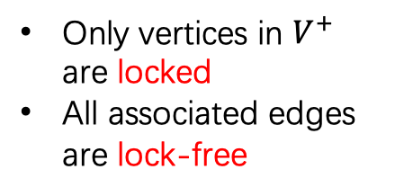
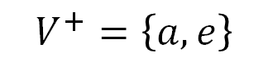
Parallel $k$-Core Maintenance
Existing parallel methods [7, 8, 9] are based on Traversal algorithm
We first propose a Simplified-Order algorithm
Then, we propose a Parallel-Order algorithm by using locks for synchronization
$$V^{∗}=\left\{a,e\right\}$$
LockFree
LockFree
$$V^{+}=\left\{a,e\right\}$$
w
u
w
u
Only vertices in $V^{+}$ are locked
All associated edges are lock-free
1
2
Lock
Lock
v
a
v
a
a
e
LockFree
e
4
3
4
LockFree
b
b
core number 1
d
c
LockFree
core number 2
core number 3
[7] Na Wang, Dongxiao Yu, Hai Jin, Chen Qian, Xia Xie, and Qiang-Sheng Hua. Parallel algorithm for core maintenance in dynamic graphs. ICDCS 2017
[8] Hai Jin, Na Wang, Dongxiao Yu, Qiang Sheng Hua, Xuanhua Shi, and Xia Xie. Core Maintenance in Dynamic Graphs: A Parallel Approach Based on Matching. TPDS 2018
[9] Qiang-Sheng Hua, Yuliang Shi, Dongxiao Yu, Hai Jin, Jiguo Yu, Zhipen Cai, Xiuzhen Cheng, and Hanhua Chen. Faster parallel core maintenance algorithms in dynamic graphs. TPDS 2019.

Slide 11


Studies of $k$-Core Maintenance
Na Wang et al., Superior
Edge Set
ICDCS [7]
Hai Jin et al., Matching Edge Set
ICDCS [8]
Qiang-Sheng Hua et al., Edge Join, TPDS [9]
Bin Guo et al.,
Parallel Order
[10]
Parallel
Ahmet Erdem Saríyüce et al., Streaming VLDB[5]
Ahmet Erdem Sarıyüce et al., Traversal
VLDB [6]
Bin Guo et al., Simplified Order
[13]
Yikai Zhang et al., Order
ICDE[4]
Sequential
2013
2016
2017
2018
2019
2022
We are here
much faster
Our methodology can also be applied to $k$-truss maintenance, $k$-clique maintenance, SCC maintenance
Notes:
For five years , no one has make a significant advancement. They ignore that Order is much faster than Traversal. We have made a giant leap. 24 font

Slide 12
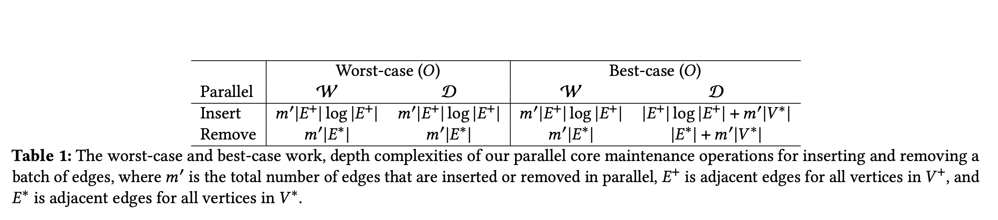
Time Complexity
Here, $m′$is total number of inserted edges
And $E^{+}$ is all associated edges for all vertices in $V^{+}$, so does $V^{∗}$
In the worst case, all workers execute as one blocking chain and reduce to sequential version
The worst case is unlikely to happen over real graphs
The best case has high speedups

Slide 13
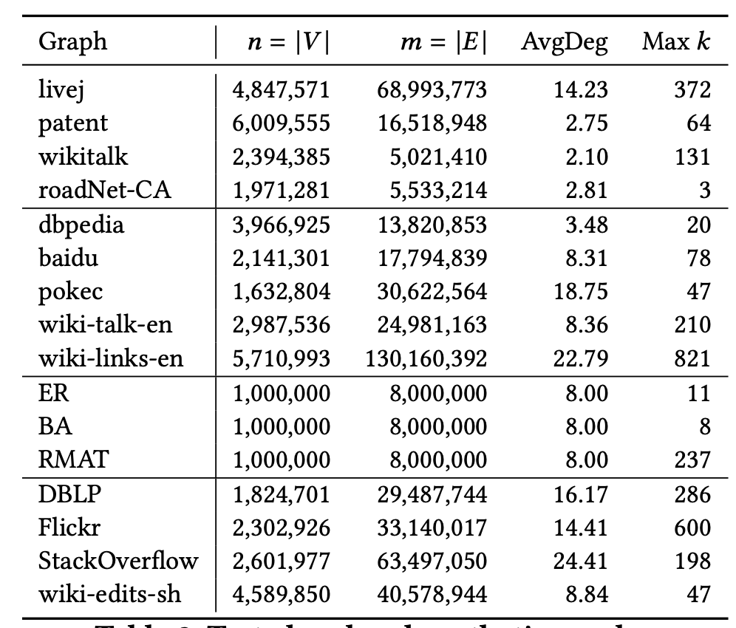
Tested Graphs
Social Networks
Road Network
Social Networks
Static Graphs
Hyperlink Network
Synthetic Network
Temporal Graphs
Dynamic Graphs
For static graphs, randomly select 100,000 edges
For dynamic graphs, select 100,000 edges in a continuous time range
Notes:
Erd¨os-R´enyi graph model (which generates a random graph),
the Barabasi-Albert graph model (which generates a graph with power-law degree distribution),
and the R-MAT graph model (which generates large-scale realistic graph similar to social networks), respectively

Slide 14
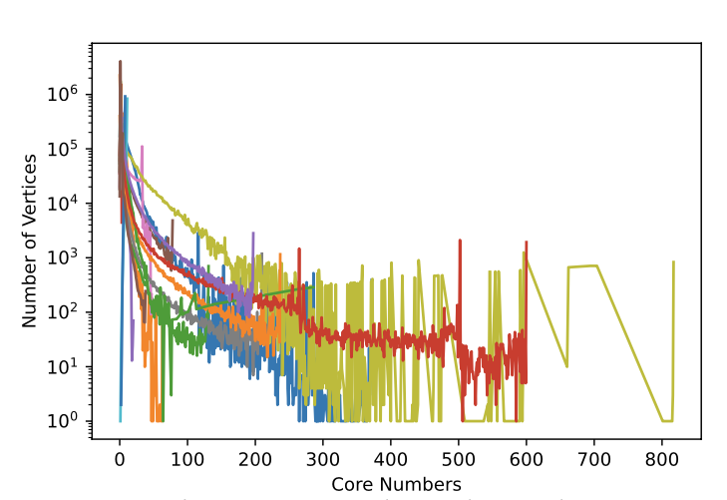
The Core Number Distribution of Vertices
A large portion of vertices have small core numbers
All compared methods have limited parallelism: vertices with the same core number can only be processed by a single worker at the same time
Our methods do not have such limitation
The number of vertices (y-axis) with a same core number (x-axis)

Slide 15
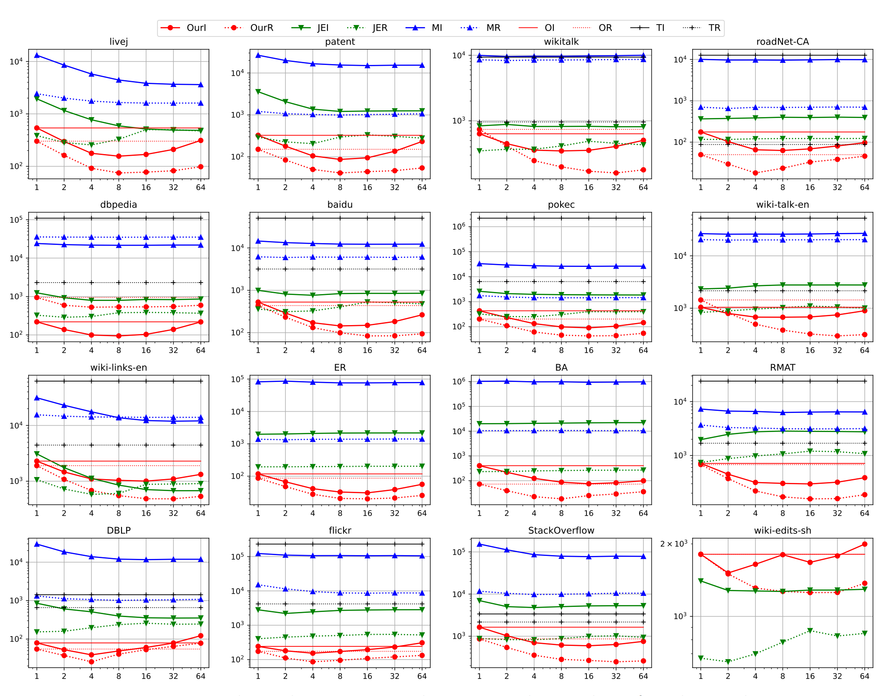
OurI | Our Insert
OurR | Our Remove
JEI | Join Edge Insert
JER | Join Edge Remove
MI | Match Edge Insert
MR | Match Edge Remove
OI | Sequential Order Insert
OR | Sequential Order Remove
TI | Sequential Traversal Insert
TR | Sequential Traversal Remove
Running time (ms)
With 1-worker, OurI and OurR is faster than JEI and JER
With 4 to 16-worker, OurI and OurR always has higher speedups than JEI and JER
Number of workers

Slide 16
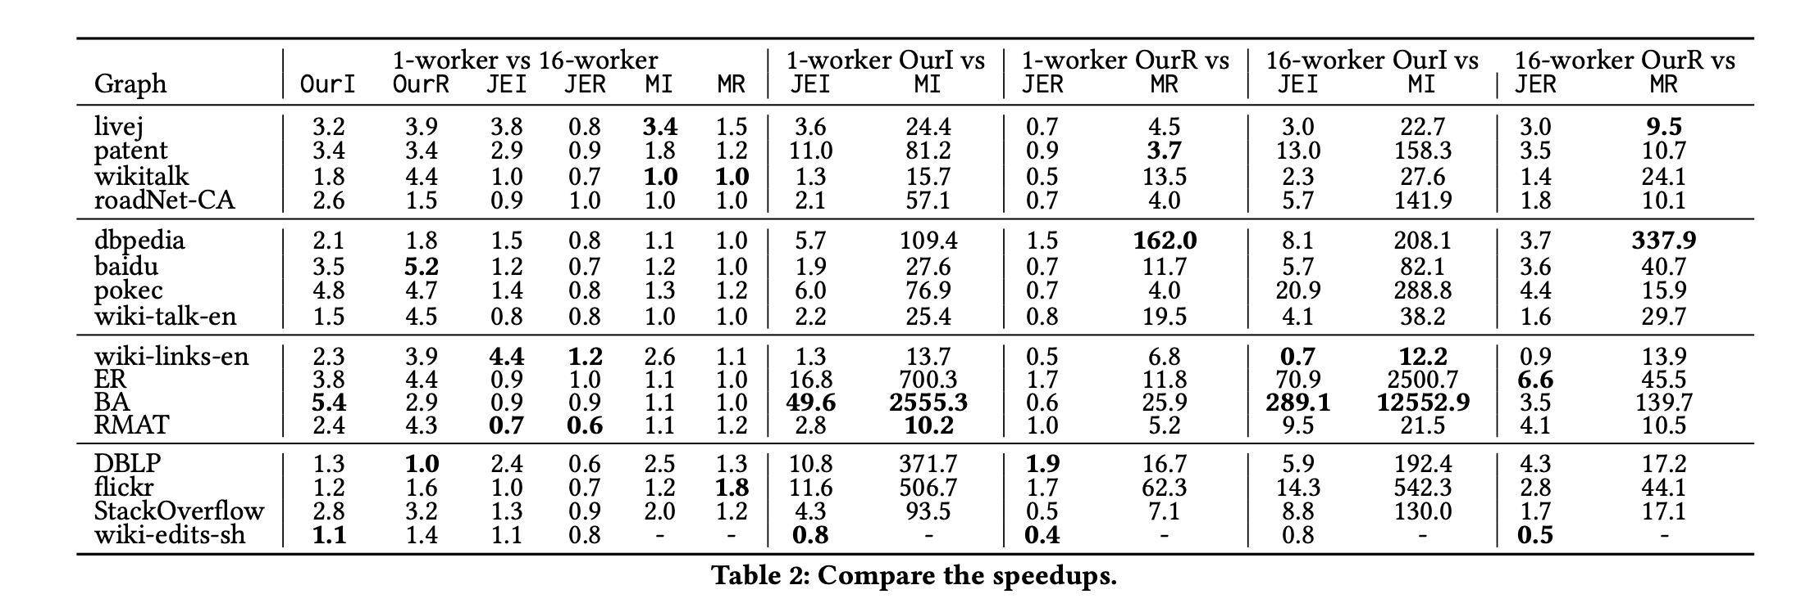
OurI | Our Insert
OurR | Our Remove
JEI | Join Edge Insert
JER | Join Edge Remove
MI | Match Edge Insert
MR | Match Edge Remove
OI | Sequential Order Insert
OR | Sequential Order Remove
TI | Sequential Traversal Insert
TR | Sequential Traversal Remove
For 1-worker vs 16-workers, OurI and OurR have speedups up to 5.4 and 5.2, respectively, higher than JEI and JIR
For 1-worker OurI vs JEI, OurI has speedups up to 49.6
For 1-worker OurR vs JER, OurR has speedups up to 1.9
For 16-worker OurI vs JEI, OurI has speedups up to 289
For 16 –worker OurR vs JER, OurR has speedups up to 6.6

Slide 17
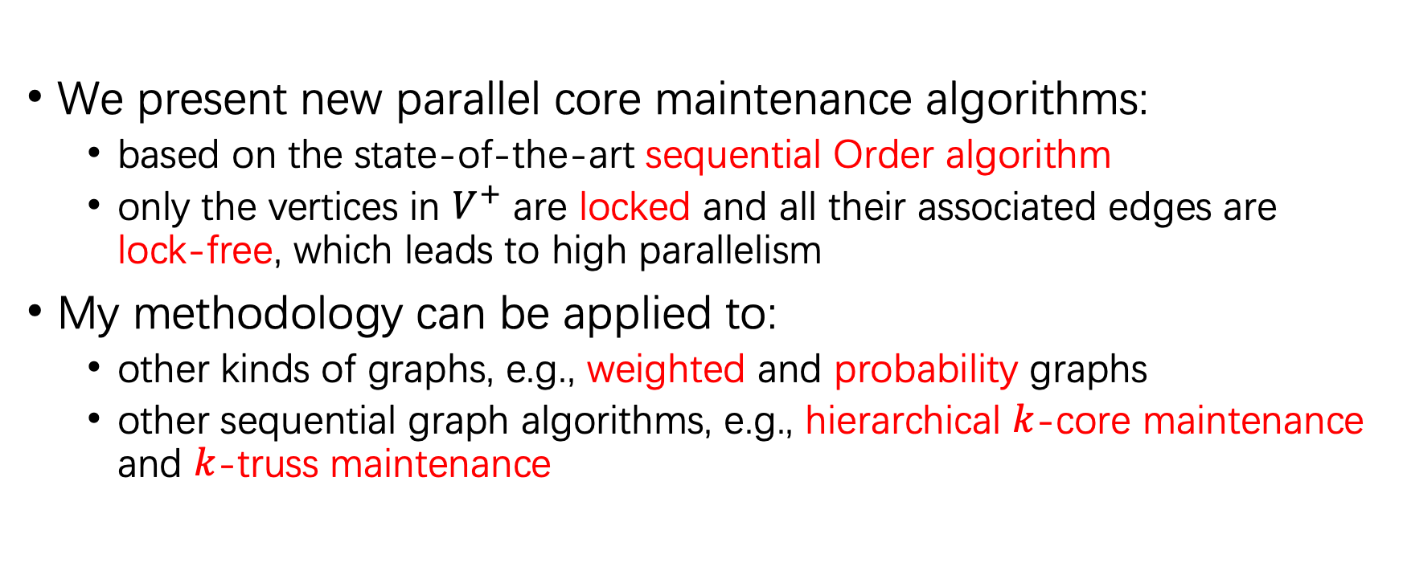
Summary and Future Work
We present new parallel core maintenance algorithms:
based on the state-of-the-art sequential Order algorithm
only the vertices in $V^{+}$ are locked and all their associated edges are lock-free, which leads to high parallelism
My methodology can be applied to:
other kinds of graphs, e.g., weighted and probability graphs
other sequential graph algorithms, e.g., hierarchical $k$-core maintenance and $k$-truss maintenance
Notes:
https://github.com/Itisben/Parallel-CoreMaint

Slide 18
Reference
[1] Kong, Yi-Xiu, et al. "k-core: Theories and applications." Physics Reports 832 (2019): 1-32.
[2] Burleson-Lesser, Kate, et al. "K-core robustness in ecological and financial networks." Scientific reports 10.1 (2020): 1-14.
[3] Lotito, Quintino Francesco, and Alberto Montresor. "Efficient Algorithms to Mine Maximal Span-Trusses From Temporal Graphs." arXiv preprint arXiv:2009.01928 (2020).
[4] Yikai Zhang, Jeffrey Xu Yu, Ying Zhang, and Lu Qin. A fast order-based approach for core maintenance. In Proceedings - International Conference on Data Engineering, pages 337–348, 2017.
[5] Ahmet Erdem Saríyüce, Buğra Gedik, Gabriela Jacques-Silva, Kun-Lung Wu, and Ümit V Çatalyürek. Streaming algorithms for 𝑘 -core decomposition. Proceedings of the VLDB Endowment, 6(6):433–444, 2013.
[6] Ahmet Erdem Sarıyüce, Buğra Gedik, Gabriela Jacques-Silva, Kun-Lung Wu, and Ümit V Çatalyürek. Incremental 𝑘 -core decomposition: algorithms and evaluation. The VLDB Journal, 25(3):425–447, 2016

Slide 19
[7] Na Wang, Dongxiao Yu, Hai Jin, Chen Qian, Xia Xie, and Qiang-Sheng Hua. Parallel algorithm for core maintenance in dynamic graphs. In 2017 IEEE 37th International Conference on Distributed Computing Systems (ICDCS), pages 2366–2371. IEEE, 2017.
[8] Hai Jin, Na Wang, Dongxiao Yu, Qiang Sheng Hua, Xuanhua Shi, and Xia Xie. Core Maintenance in Dynamic Graphs: A Parallel Approach Based on Matching. IEEE Transactions on Parallel and Distributed Systems, 29(11):2416–2428, nov 2018.
[9] Qiang-Sheng Hua, Yuliang Shi, Dongxiao Yu, Hai Jin, Jiguo Yu, Zhipen Cai, Xiuzhen Cheng, and Hanhua Chen. Faster parallel core maintenance algorithms in dynamic graphs. IEEE Transactions on Parallel and Distributed Systems, 31(6):1287–1300, 2019.
[10] Parallel Order-Based Core Maintenance in Dynamic Graphs B Guo, E Sekerinski - arXiv preprint arXiv:2210.14290, 2022 All 2 versions
[11] Efficient parallel graph trimming by arc-consistency B Guo, E Sekerinski - The Journal of Supercomputing, 2022
[12] δ-Transitive closures and triangle consistency checking: a new way to evaluate graph pattern queries in large graph databases Y Chen, B Guo, X Huang - The Journal of Supercomputing, 2020
[13] Guo, Bin, and Emil Sekerinski. "Simplified Algorithms for Order-Based Core Maintenance." arXiv preprint arXiv:2201.07103 (2022).
[14] Guo, Bin, and Emil Sekerinski. "New Parallel Order Maintenance Data Structure." arXiv preprint arXiv:2208.07800 (2022).

Slide 20
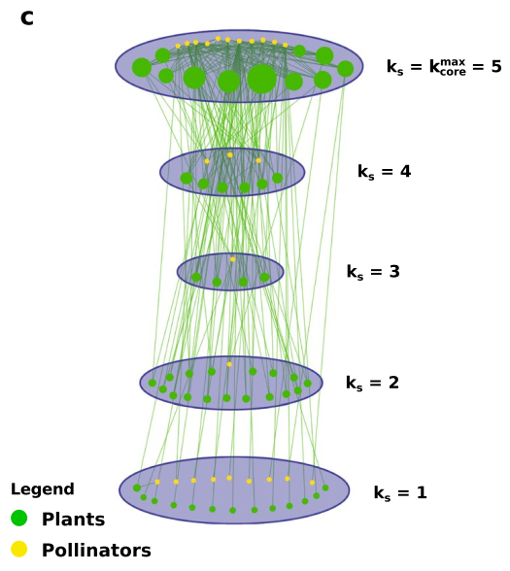
Applications in Ecology
max core number
Ecological Networks
Vertices | Plants and Pollinators
Edges | Plant-Pollinator Interaction
The size of max-core are much large than 1-core
The extinction of species in max-core have huge effect to the mutualistic structure [2]
[2] Burleson-Lesser, Kate, et al. "K-core robustness in ecological and financial networks.”
Scientific reports 10.1 (2020): 1-14.
Notes:
Insect and bees， mutualistic(共生)

Slide 21
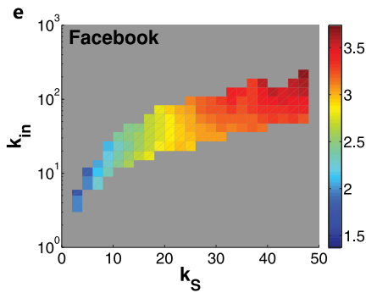
Applications in Social Networks
influence
Social Networks, e.g. Facebook and Twitter
Vertices | Individuals
Edges | Relations
indegree
For vertices, larger core numbers and larger indegrees indicate higher influence [1]
core number
Use core numbers to predicts the influence of spreading in social networks [1]
[1] Kong, Yi-Xiu, et al. "k-core: Theories and applications." Physics Reports 832 (2019): 1-32.
Notes:
Reference add to here

Slide 22
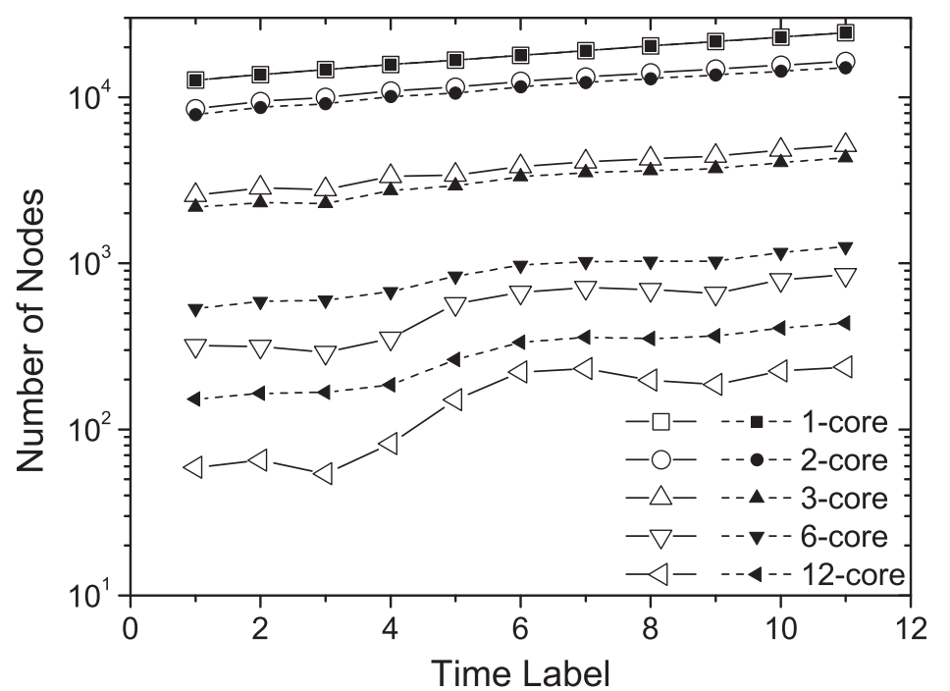
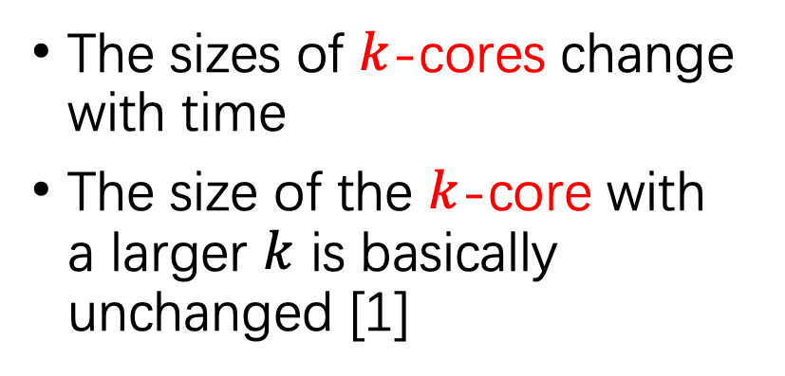
Applications on Analyzing Internet Networks
Internet Networks
Vertices | Websites
Edges | Links Between Websites
The sizes of $k$-cores change with time
The size of the $k$-core with a larger $k$ is basically unchanged [1]
From Dec. 2001 to Dec. 2006 with six months interval
[1] Kong, Yi-Xiu, et al. "k-core: Theories and applications." Physics Reports 832 (2019): 1-32.

Slide 23
1-core
1-core
1-core
2-core
2-core
3-core

Slide 24
1-core
1-core
2-core
2-core
w
u
w
u
v
a
a
v
a
a
e
e
3-core
3-core
b
b
d
c
d
c

